Slide 1
Exploring the Bombardment History of the Inner Solar System
William Bottke
Center for Lunar Origin and Evolution (CLOE)
Southwest Research Institute, Boulder, CO

Slide 2
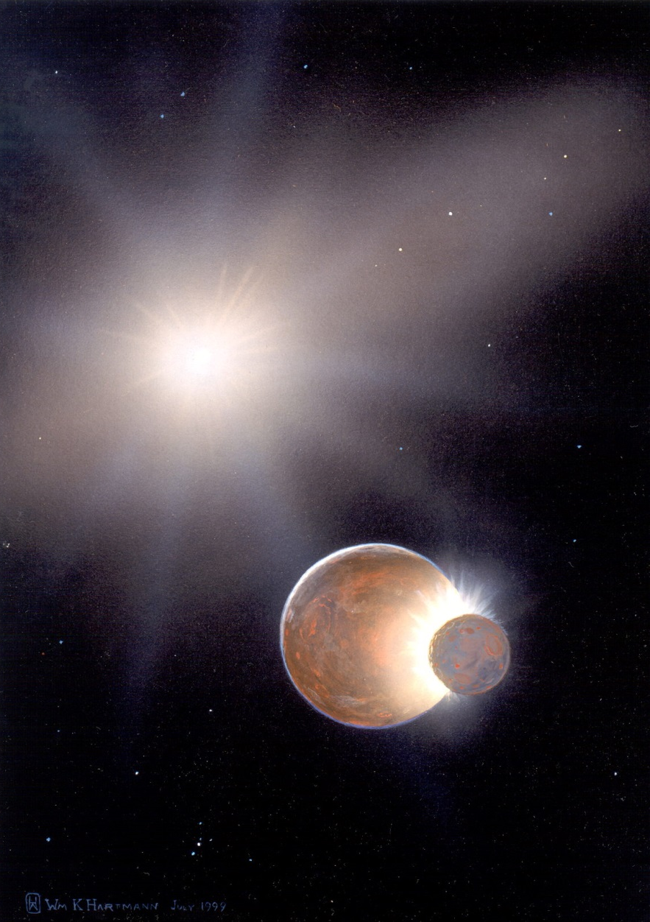
Understanding Lunar Bombardment
The Moon has the most complete and clear history available of last 4.5 Gy of Solar System evolution.
The Moon is a “Rosetta stone” telling us about:
The unknown nature of the primordial Earth!
The critical last stages of planet formation throughout solar system!

Slide 3
Prologue:
The Set Up
Mare Moscoviense; Kaguya Mission
Notes:
In this talk I will show you that
Southwest Research Institute® is at the forefront of understanding the solar wind that fills the space around our solar system and its interaction at the galactic frontier!

Slide 4
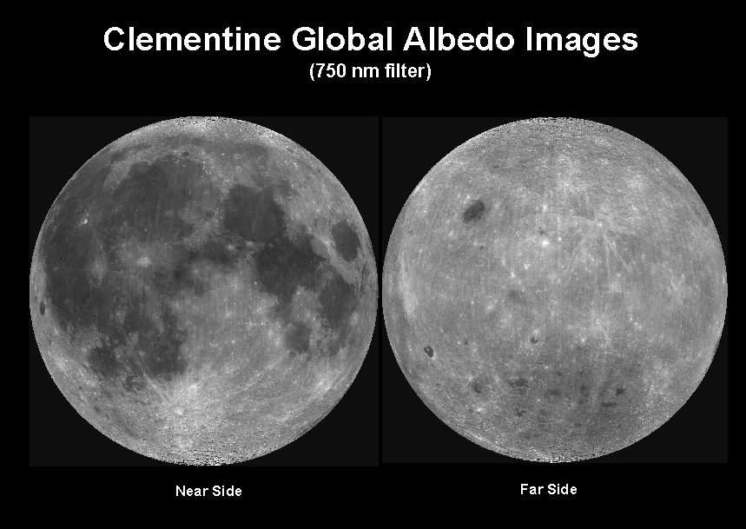
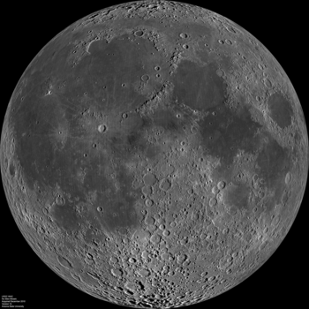
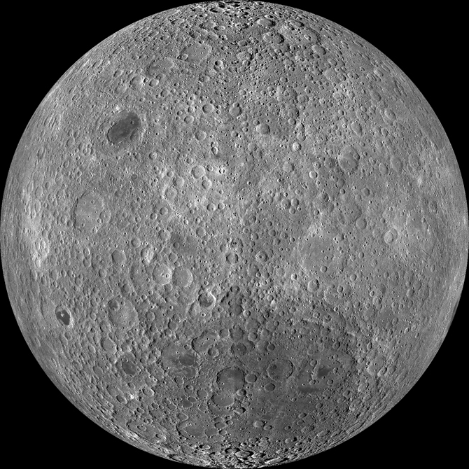
Lunar Basins
Estimates indicate that ~40 lunar basins (D > 300 km) formed between 3.7 and ~4.5 billion years ago.
Wilhelms (1987); Frey et al. (2008); Images from the LRO spacecraft.; GRAIL Data

Slide 5
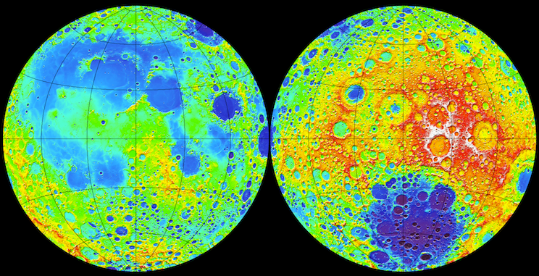
Lunar Basins
South Pole Aitken Basin (> 3.9 Ga)
The oldest basin by superposition is South Pole-Aitken basin (~2400 km). SPA’s absolute age is unknown.
Wilhelms (1987); Topography from LOLA on LRO

Slide 6
Lunar Basins
Imbrium Basin (3.85-3.91 Ga)
Orientale Basin (3.80-3.72 Ga)
Basins with “accepted” ages are big/young: (3.7-3.9 Ga): Imbrium (1,200 km) and Orientale (930 km).
Sample references: Wilhelms (1987); Stoffler and Ryder (2001); Topography from LOLA on LRO

Slide 7
Planetary Chronology from Crater Counts
Relative surface ages can be derived from crater counts.
Absolute ages of various surfaces can be estimated using samples or by understanding the impact flux over time.

Slide 8
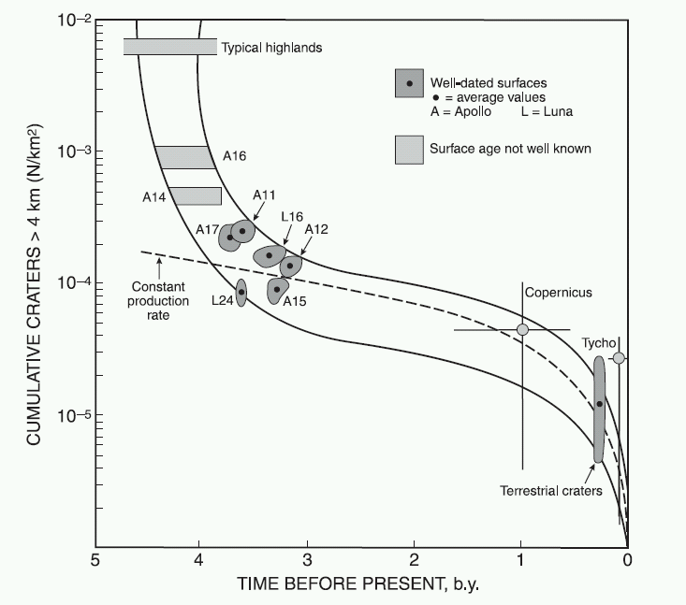
The Lunar Impact Rate
Lunar impact rate has been variable with time.
Hartmann et al. (1981); Horz et al. (1991)

Slide 9
The Lunar Impact Rate
Lunar impact rate has been variable with time.
Crater production rates >100 times higher >3.8 billion years ago.
Hartmann et al. (1981); Horz et al. (1991)

Slide 10
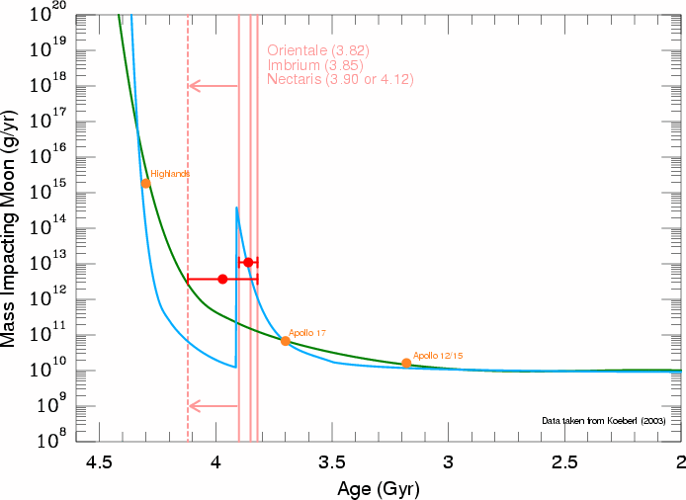
End Member Model #1
Were many large basins produced by a spike of impactors near ~ 3.9 Ga, creating a terminal cataclysm?
Sample reference: Tera et al. (1974)

Slide 11
End Member Model #2
Or were most produced by a declining bombardment of leftover planetesimals from terrestrial planet formation?
Sample reference: Hartmann et al. (2000)

Slide 12
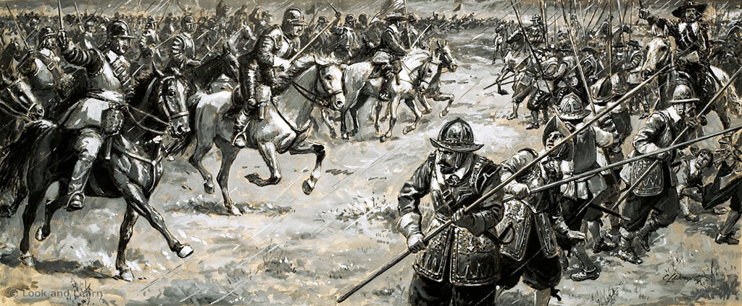
The Thirty Years War
Since the mid-1970’s, two camps have battled over how to interpret the lunar bombardment data.
A deadlock exists, though new data and modeling work may be finally riding to the rescue!

Slide 13
Do We Need a Terminal Catacylsm?
Orientale Basin; Kaguya Mission
Notes:
In this talk I will show you that
Southwest Research Institute® is at the forefront of understanding the solar wind that fills the space around our solar system and its interaction at the galactic frontier!

Slide 14
Planet Formation in the Inner Solar System
Sea of bodies:
Moon to Mars-sized bodies
Smaller planetesimals.
Collisions create planets!
Some bodies reside at high eccentricities & inclinations.
Location of
Asteroid Belt
Protoplanets
Planetesimals
Sample references: O’Brien et al. (2006); Raymond et al. (2006)

Slide 15
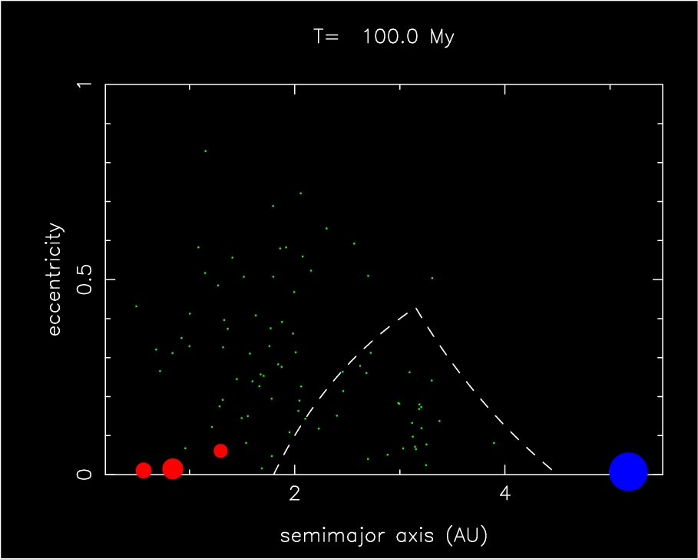
Leftover Planetesimals
Leftover Planetesimals
from Terrestrial Planet Region
Bottke et al. (2007)

Slide 16
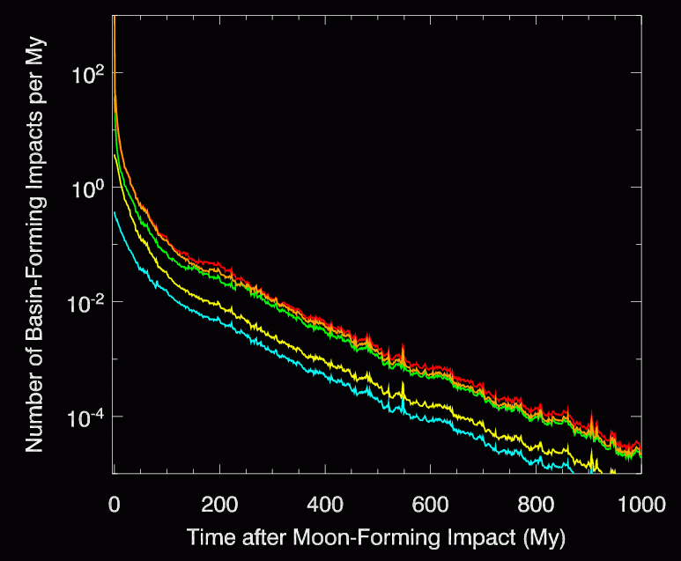
Lunar Impact Rate from Leftover Planetesimals
Model
Dynamical evolution
Collisional evolution
Assumed population had a range of starting masses.
Goal: Reproduce Imbrium and Orientale at their inferred ages.
Imbrium & Orientale Formation Time
0.5 M⊕, 5 M⊕, 50 M⊕
0.05 M⊕, 0.005 M⊕
Imbrium Basin (3.91-3.82 Ga)
Bottke et al. (2007)

Slide 17
Lunar Impact Rate from Leftover Planetesimals
LHB population self-destructs!
We find an impact rate of 10-4 basins / My × 200 My = 0.02 basins.
We see 2 basins!
Imbrium & Orientale Formation Time
0.5 M⊕, 5 M⊕, 50 M⊕
0.05 M⊕, 0.005 M⊕
Imbrium Basin (3.91-3.82 Ga)
Bottke et al. (2007)

Slide 18
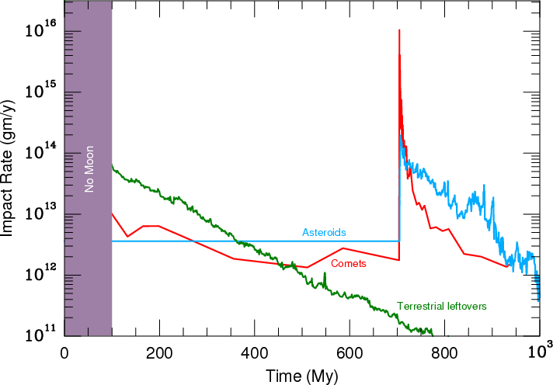
The Early Lunar Impact Rate
For illustration purposes only!
Cataclysm Needed?
Leftover Planetesimals
Some ancient basins come from leftover planetesimals.
Perhaps the youngest ones do need to come from a “terminal cataclysm”

Slide 19
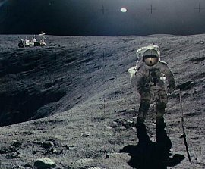
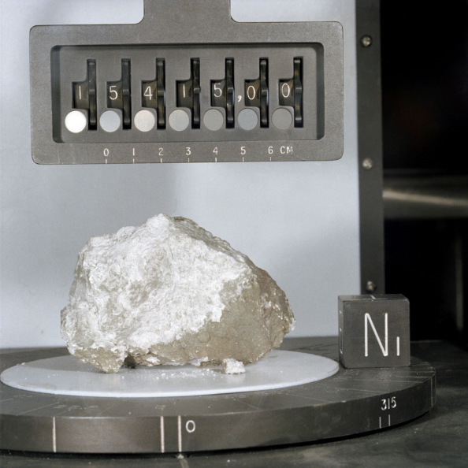
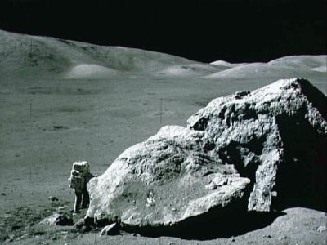
The Late Heavy Bombardment: Sample Stories
“A rock is the most efficient way to encode information about a planet.”

Slide 20
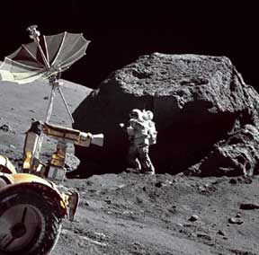
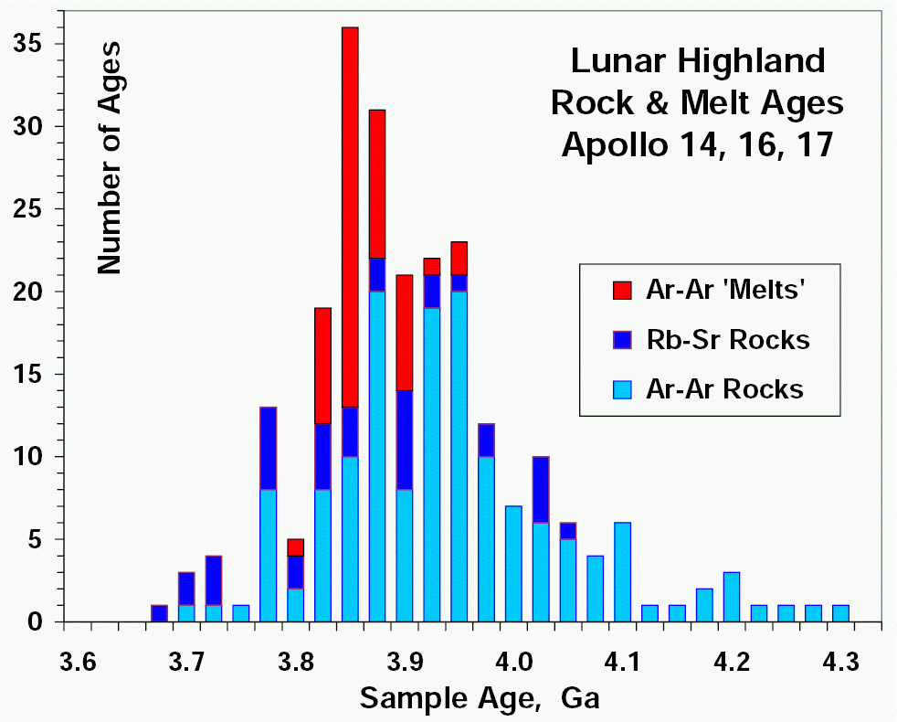
Lunar Impact Sample Ages
Apollo astronauts returned rocks melted or shocked by impacts with ages between 3.7-4.1 Ga.
The impact melts cluster near 3.8-4.0 Ga.
Bogard (2006; 2011)

Slide 21
Problem: Are We Biased? We can only measure the samples we have…
Imbrium Basin
A17
A15
L24
L20
A14
A11
L16
A12
A16
Illustration from Tim Swindle

Slide 22
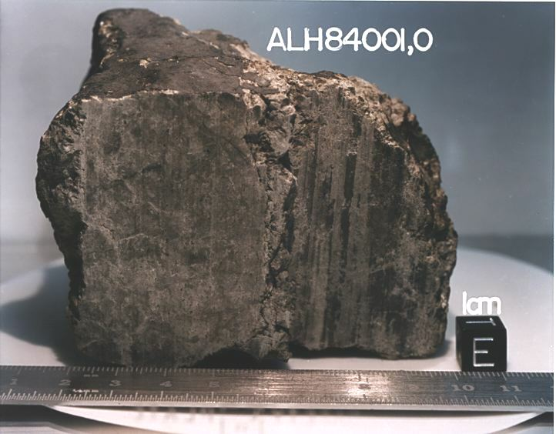
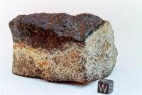
Mars Meteorites
ALH84001 is old enough to have seen cataclysm:
Crystallization age ~4.1 Ga (or 4.5 Ga crystalization and disturbance at ~4.1 Ga).
Carbonate phases have ages of 3.9-4.0 Ga.
Shergottites are young, but have strange Pb-Pb ages of ~4.1 Ga.
Source region disturbance?
Borg et al. (1999); Bouvier et al. (2008); Lapen et al. (2010); Nyquist et al. (2013)

Slide 23
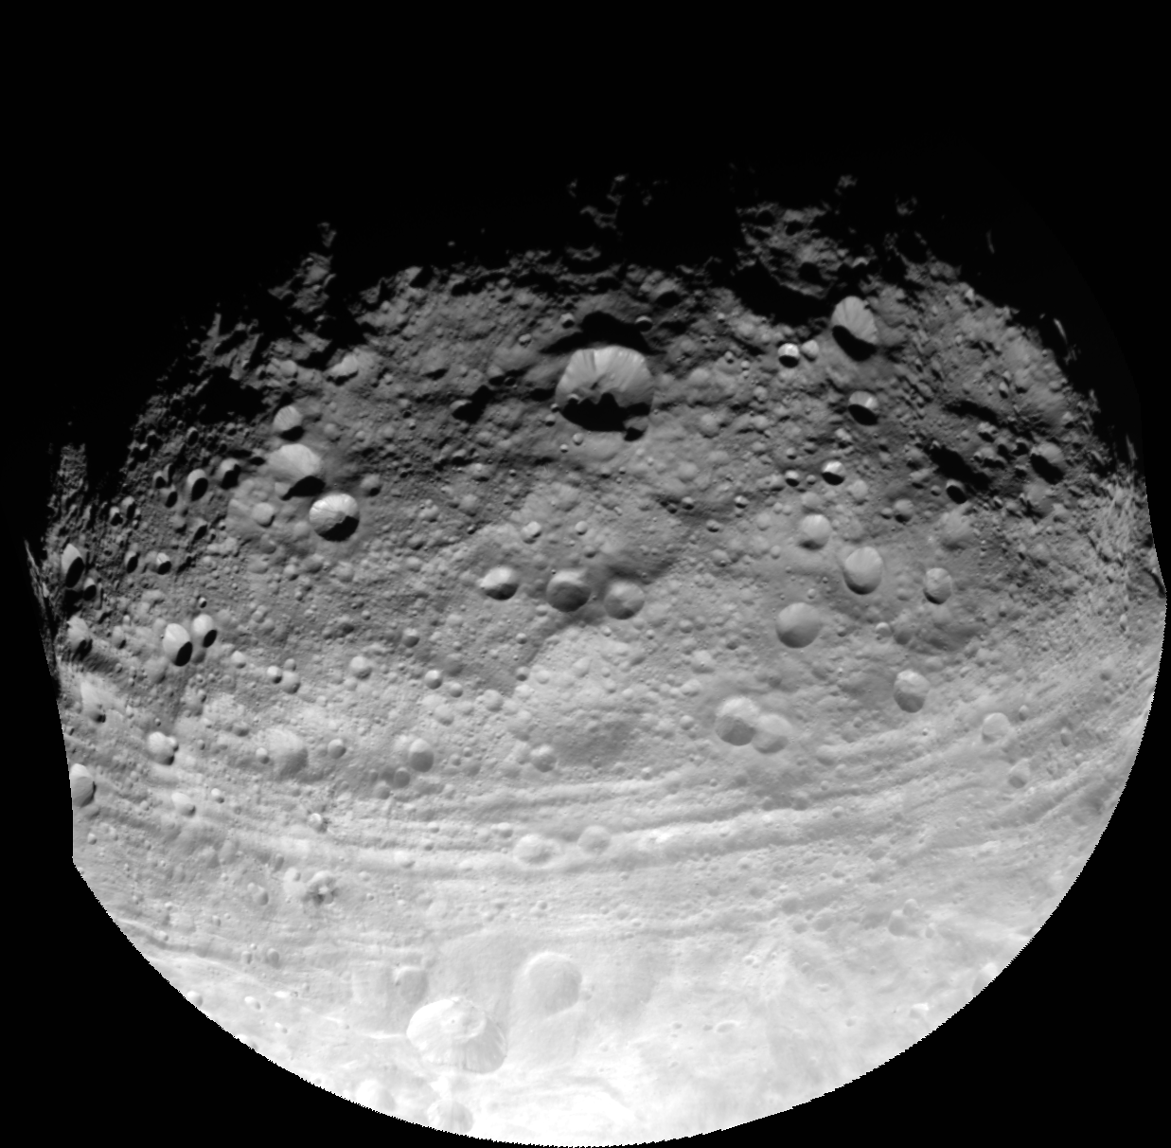
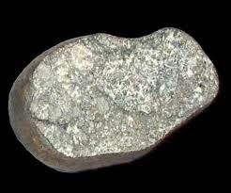
How Did the Late Heavy Bombardment Affect (4) Vesta and the HEDs?
We turn to the HEDs, which can tell us the history of Vesta and perhaps that of the main asteroid belt itself.

Slide 24
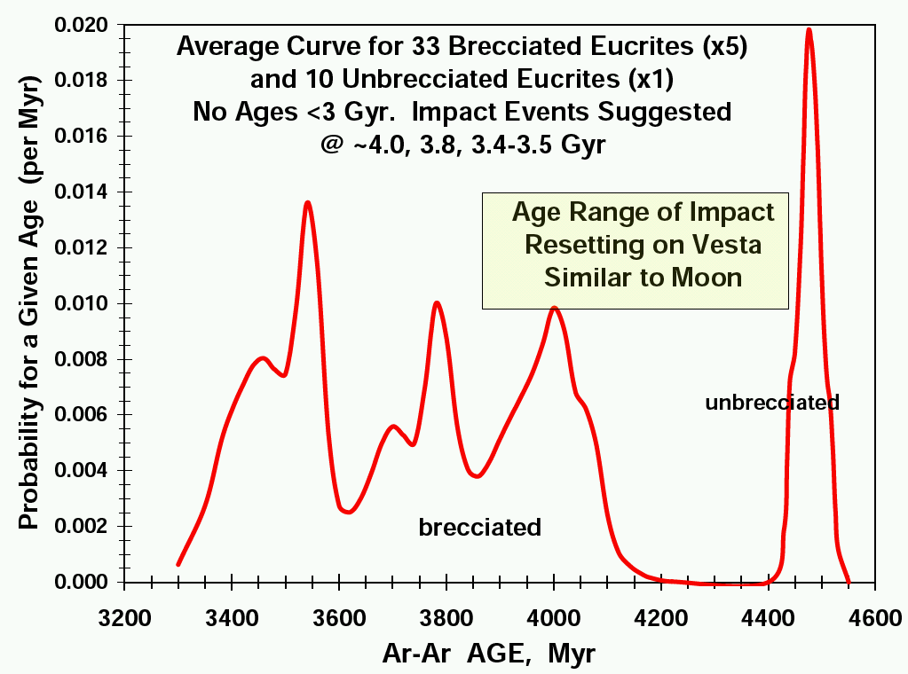
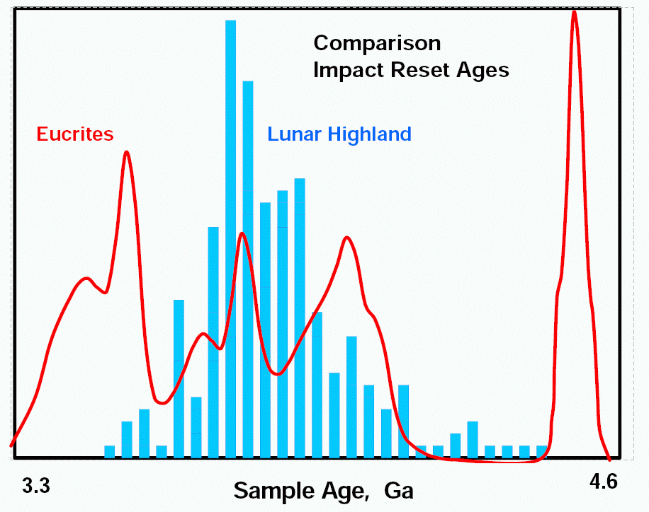
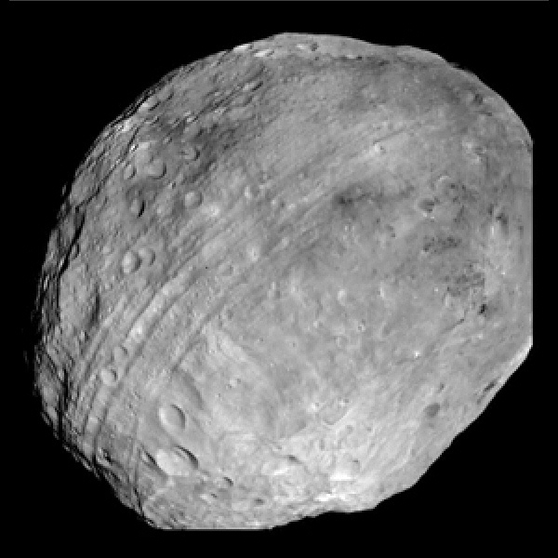
Vesta and the Eucrites
Many ages with 3.3-4.1 Ga, suggestive of lunar cataclysm.
The cataclysm cannot be local to Moon or from Imbrium alone!
Not a sharp spike. Few events between 4.1 and 4.5 Ga.
Bogard (1995; 2011); Bogard and Garrison (2003); Cohen et al. (2007)

Slide 25
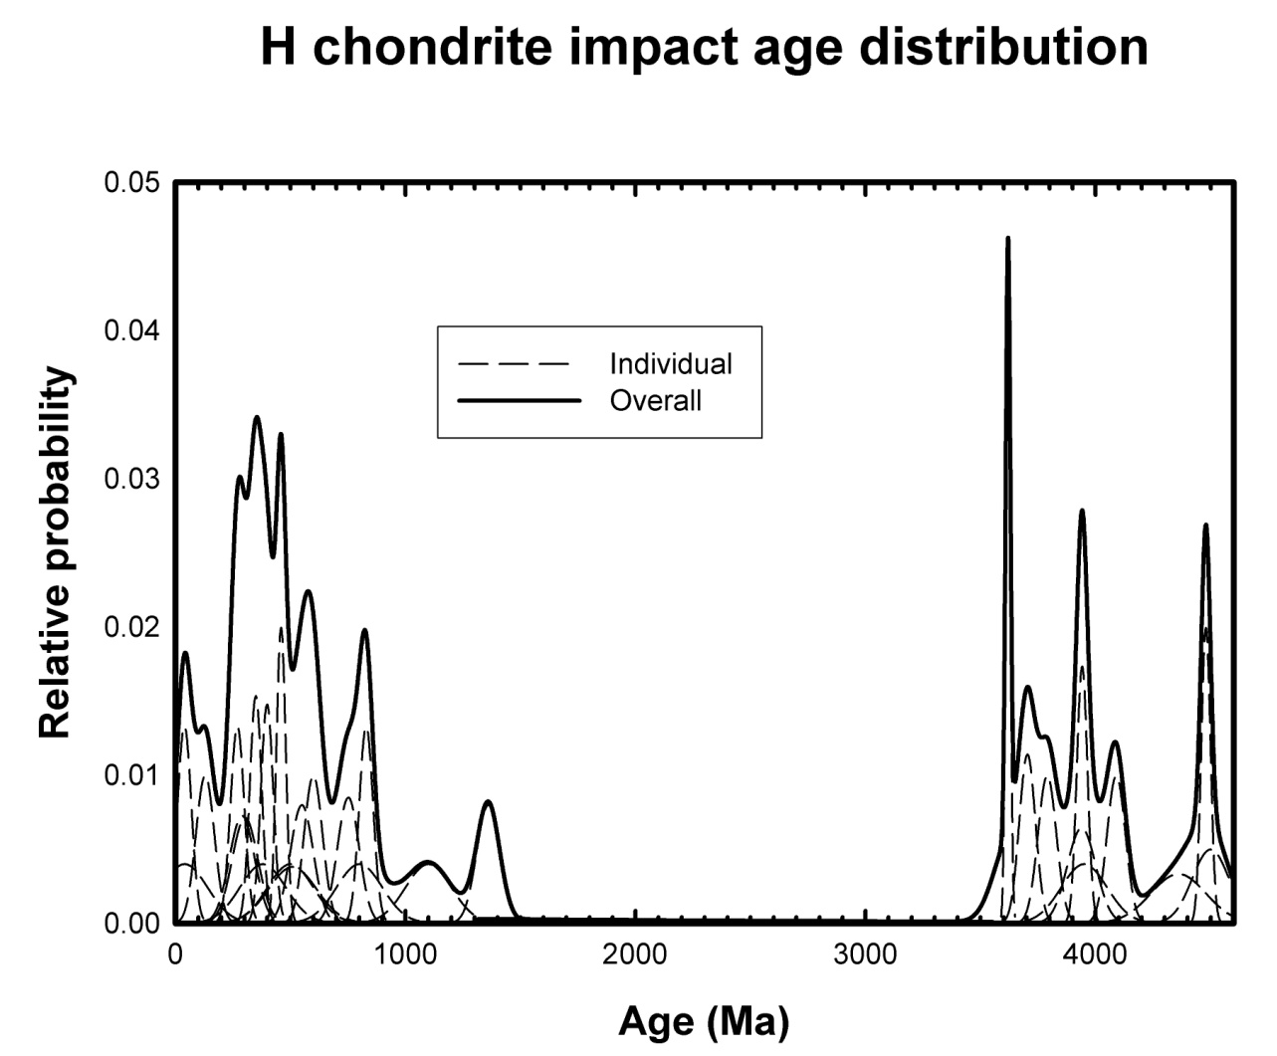
Asteroids and Meteorites: H Chondrite Parent Body
Many 3.5-4.1 Ga ages, suggestive of cataclysm.
Few with 4.1-.4.5 Ga.
Not a spike. Very similar to eucrite signature.
Some meteorites show related cataclysm ages (LLs, IIE irons, etc.)
Ages of impact-reworked (melted or shocked) H chondrites. Swindle et al. (2008)

Slide 26
Summary of Data
A solar-system-wide bombardment event may have started near ~4.1 Ga.
Most evidence for a narrow ~3.8-4.0 Ga “spike” comes from samples near Imbrium.
Major lunar events lasted until 3.7-3.8 Ga, but extended to ~3.5 Ga in the asteroid belt. Why?

Slide 27
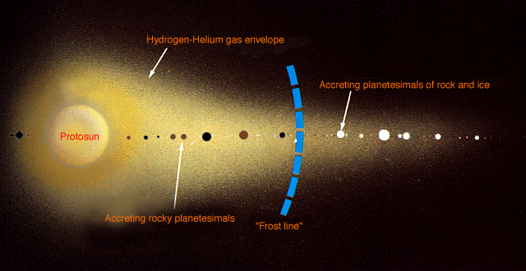
Planet Formation in the Outer Solar System
Planet formation events in the outer solar system may have a critical effect on what happens to the Moon and other solar system bodies.

Slide 28
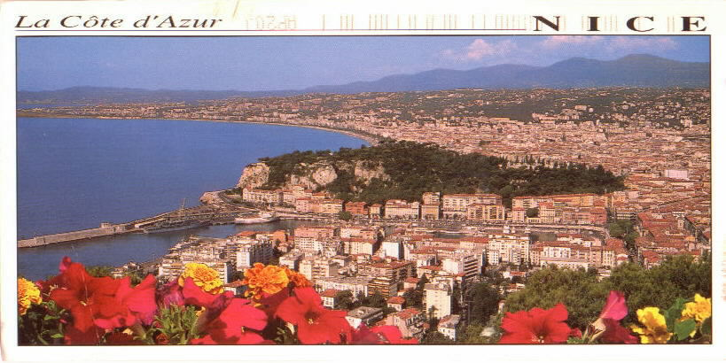
The “Nice” Model of the Lunar Late Heavy Bombardment
Much of this work is found in 3 Nature papers:
Tsiganis et al. (2005); Morbidelli et al. (2005); Gomes et al. (2005)

Slide 29
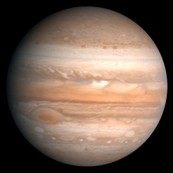
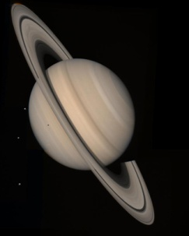
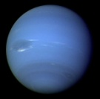
New Solar System Formation Scenario
Comets
Old view. Gas giants/comets formed near present locations (5-30 AU) and reached current orbits ~4.5 Gy ago.

Slide 30
New Solar System Formation Scenario
Comets
Old view. Gas giants/comets formed near present locations (5-30 AU) and reached current orbits ~4.5 Gy ago.
Primordial disk of comets
New view. Gas giants formed in more compact formation between 5 to ~12 AU. Massive comet population existed out to ~30 AU.
Fernandez and Ip (1986); Malholtra (1995); Thommes et al. (1999; 2003)

Slide 31
New Solar System Formation Scenario
Comets
Old view. Gas giants/comets formed near present locations (5-30 AU) and reached current orbits ~4.5 Gy ago.
Primordial disk of comets
New view. Gas giants formed in more compact formation between 5 to ~12 AU. Massive comet population existed out to ~30 AU.
Best developed and most successful scenario of this is the Nice Model.
Fernandez and Ip (1986); Malholtra (1995); Thommes et al. (1999; 2003)
Tsiganis et al. (2005)

Slide 32
Destabilizing the Outer Solar System
Tsiganis et al. (2005); Morbidelli et al. (2005); Gomes et al. (2005)
Watch what happens after 850 My!

Slide 33
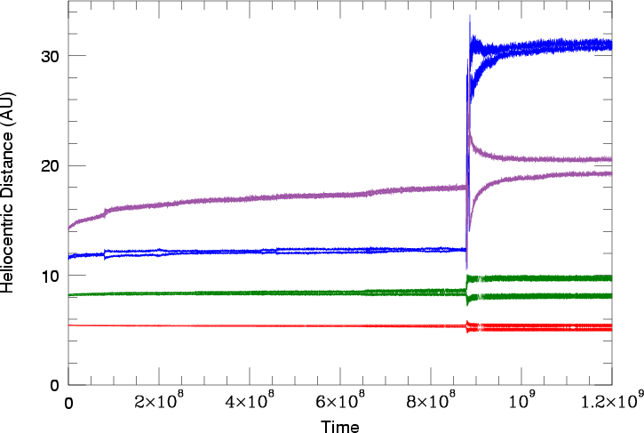
The Nice Model and the LHB
Tsiganis et al. (2005); Morbidelli et al. (2005); Gomes et al. (2005)
Jupiter/Saturn enter 1:2 mean motion resonance
The Nice model describes how Jupiter-Neptune migrated to their current orbits after a delay of many hundreds of My.

Slide 34
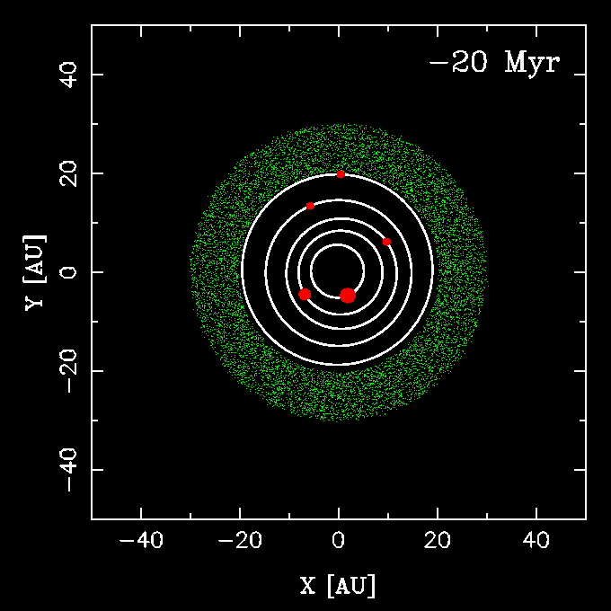
More Nice: Ejected Planets, Different Triggers
5 Planets: Jupiter, Saturn, Uranus, Neptune 1, and Neptune 2
Nesvorny and Morbidelli (2012) explored Nice model with 4, 5, 6 giant planets.
5-6 planets work the best.
Often lose a planet, with Jupiter throwing it out of solar system.
5-6 planet systems work ~10 times more often than 4 planet systems!
Nesvorny (2011); Nesvorny and Morbidelli (2012)

Slide 35
Testing the Nice Model
The Nice model (and its variants) yield:
The orbits of giant planets.
The size and orbit distributions of the Trojan/Hilda asteroids and Kuiper belt objects.
The size and orbit distributions of the irregular satellites orbiting the giant planets.
The differentiated/non-differentiated nature of the regular satellites like Ganymede, Callisto, and Titan.
Etc.
Sample References: Morbidelli et al. (2009); Levison et al. (2009); Bottke et al. (2010); Barr & Canup (2010)

Slide 36
What About the Asteroid Belt?
Notes:
In this talk I will show you that
Southwest Research Institute® is at the forefront of understanding the solar wind that fills the space around our solar system and its interaction at the galactic frontier!

Slide 37
Effects of Sweeping υ6 Resonance
υ6 Resonance
Eccentricity
Semimajor axis (AU)
Planet migration excites (e, i) of main belt asteroids.
Many primordial main belt was ejected onto planet-crossing orbits!
Levison et al. (2001); Gomes et al. (2005); Minton and Malhotra (2009); Morbidelli et al. (2010)

Slide 38
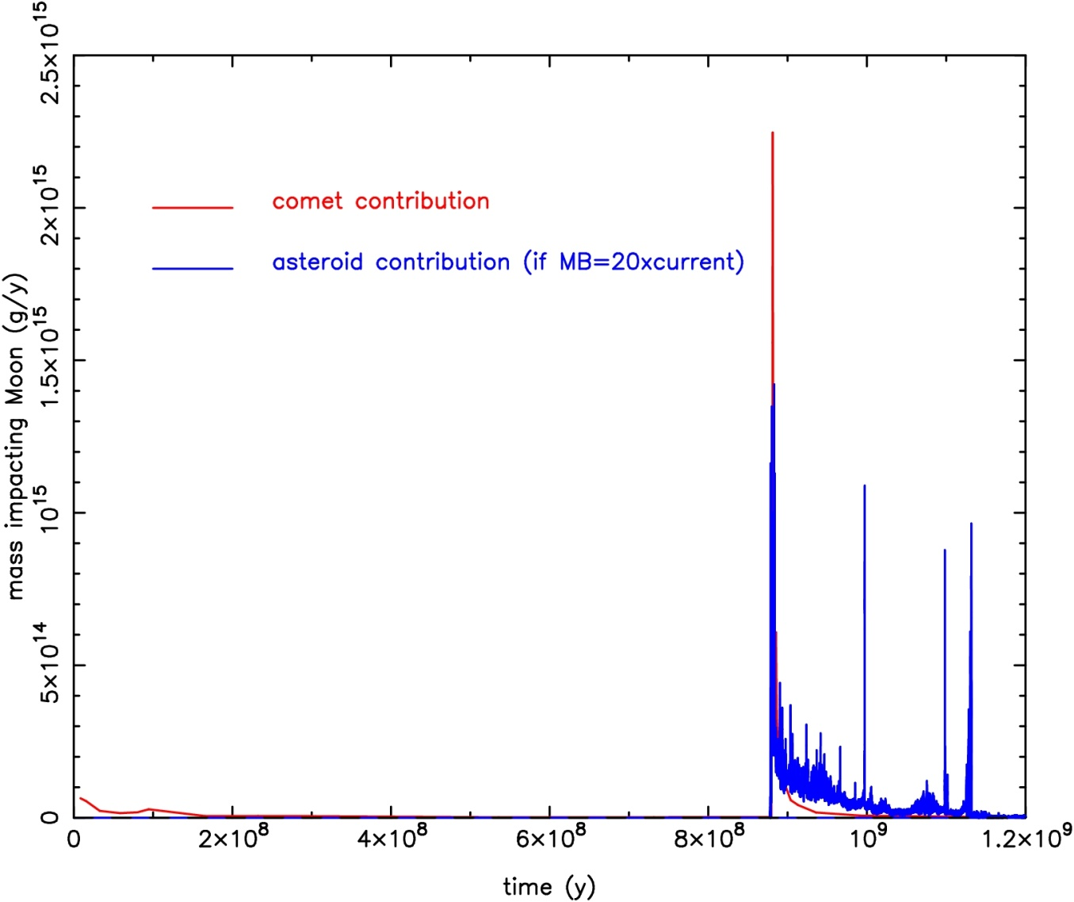
Comets and Asteroids, Hitting Together…
Levison et al. (2001); Gomes et al. (2005)
Comets
Asteroids (20 × Current Main Belt)
Note: The length of the time delay in the Nice Model is fairly arbitrary.
The Nice model predicts comets hit over first ~30 My, then ejected main belt asteroids hit over ~200 My or so.
But, it requires the main belt to lose 20 × current mass!

Slide 39
Problems, Problems…
Notes:
In this talk I will show you that
Southwest Research Institute® is at the forefront of understanding the solar wind that fills the space around our solar system and its interaction at the galactic frontier!

Slide 40
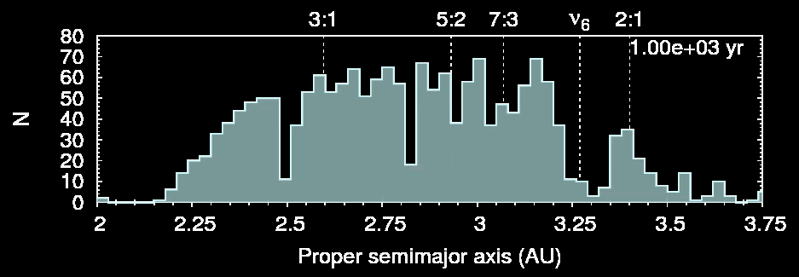
Planet Migration and Main Belt Depletion
Giant planet migration models show the main belt only lost about 25-50% of its pre-migration population.
Minton and Malhotra (2009; 2010); Morbidelli et al. (2010)

Slide 41
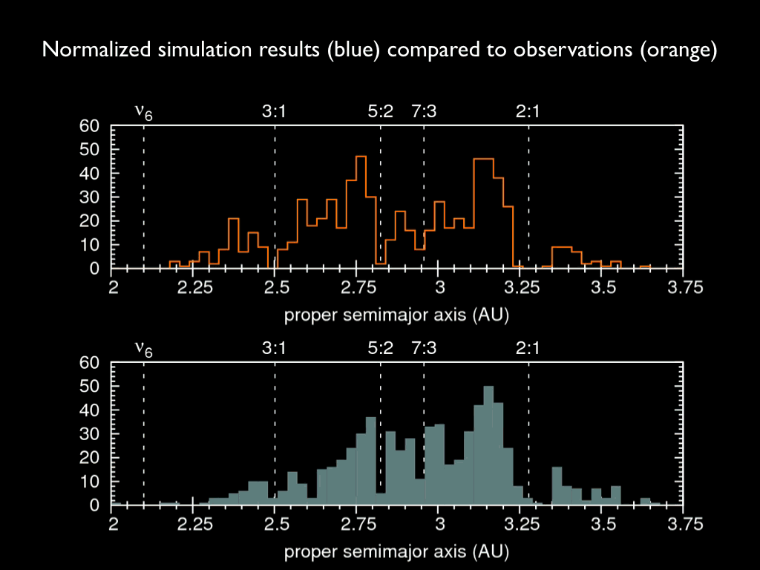
dsfd

Slide 42
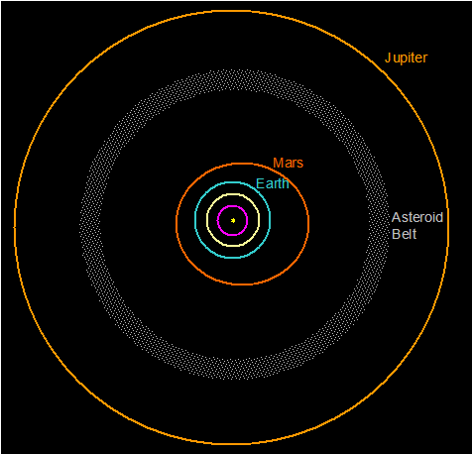
Some “Nice” LHB Problems
This only produces 2-3 lunar basins.
Comets do not appear to make up the difference.
We need more impacts over a longer interval!

Slide 43
A Hypothesized Solution
The asteroid belt ends at 2.1 AU today.
Prior to the Nice model, 1.8-2.1 AU asteroids would have been stable.
We call it the “E-belt”.
E-Belt
This population does neat things in Nice model…
Bottke et al. (2012)

Slide 44
The Great Archean Bombardment (or the Late Late Heavy Bombardment)
Bottke, Vokrouhlicky, Minton, Nesvorny,
Morbidelli, Brasser, Simonson & Levison (2012) Nature

Slide 45
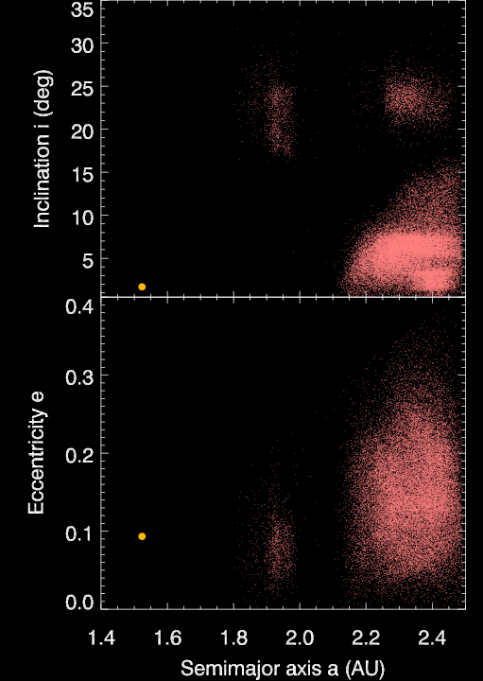
Mars and the Inner Main Belt
Orbits of inner main belt asteroids dominated by Mars and resonances.
Mars
Mars

Slide 46
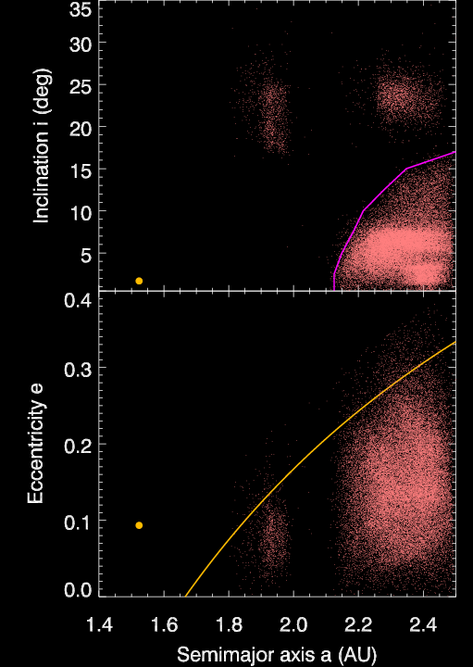
Mars and the Inner Main Belt
Orbits of inner main belt asteroids dominated by Mars and resonances.
υ₆ Resonance
Mars
Mars-Crossing Boundary
Mars

Slide 47
Mars and the Inner Main Belt
The closest reservoir of asteroids to the terrestrial planets are the Hungarias.
The population is small!
Many “exotic” asteroids there (e.g., E, X-types)
Similarities to LHB-era impactors?
Hungaria Asteroids
υ₆ Resonance
Mars
Mars-Crossing Boundary
Hungaria Asteroids
Mars

Slide 48
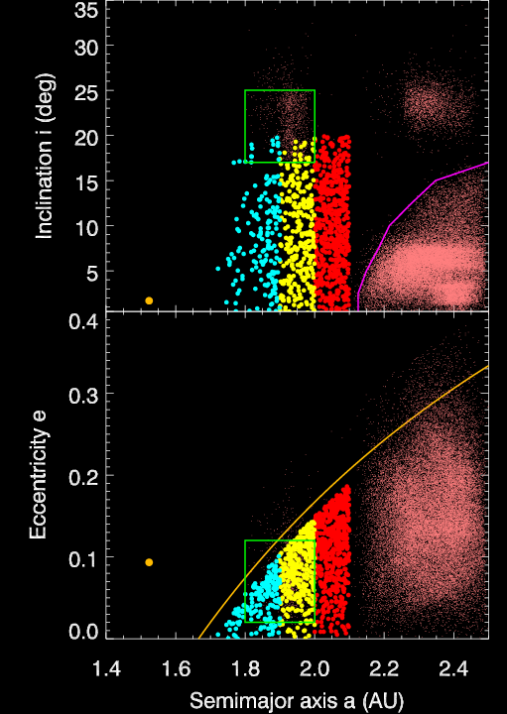
The E-Belt
We placed bodies on main belt-like orbits in gap.
Pre-LHB: -600 My to 0 My
Jovian planets in circular orbits between 5-12 AU.
Mars started on a low-e orbit
Hungaria Asteroids
υ₆ Resonance
Mars
Mars-Crossing Boundary
Hungaria Asteroids
Mars

Slide 49
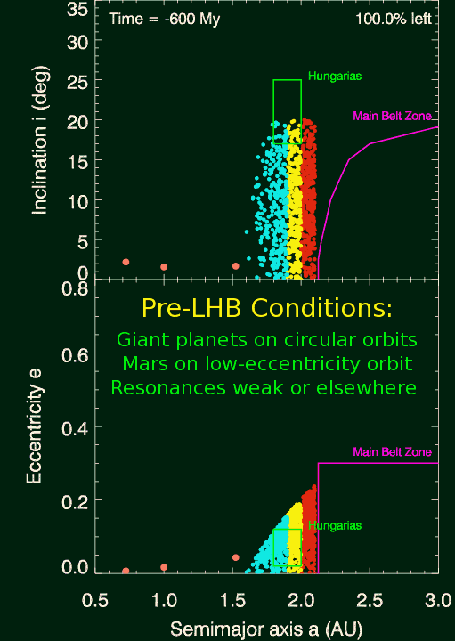
What is “Nice” About the E-Belt
Objects ~10 × more likely to hit Moon than main belt asteroids! (More bang for the buck!)
Impact velocity doubles!
LHB-era craters ~40% larger? (Marchi et al. 2012)
Great impact profiles!
Matches constraints from Earth & Moon

Slide 50
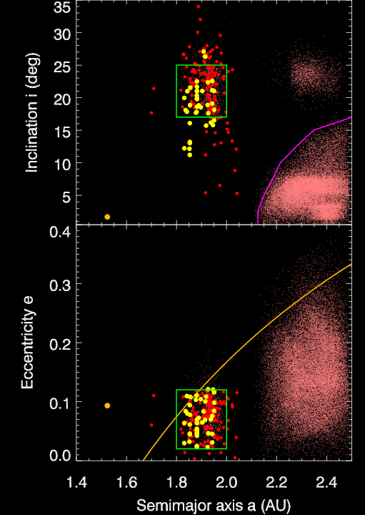
E-Belt and the Hungaria Asteroids
E-belt survivors after 4 Gy
Our model E-belt objects after 4 Gy compared to the known H < 14 Hungarias.
Observed Hungarias (H < 14)
The E-belt makes Hungarias!
Mars
Mars

Slide 51
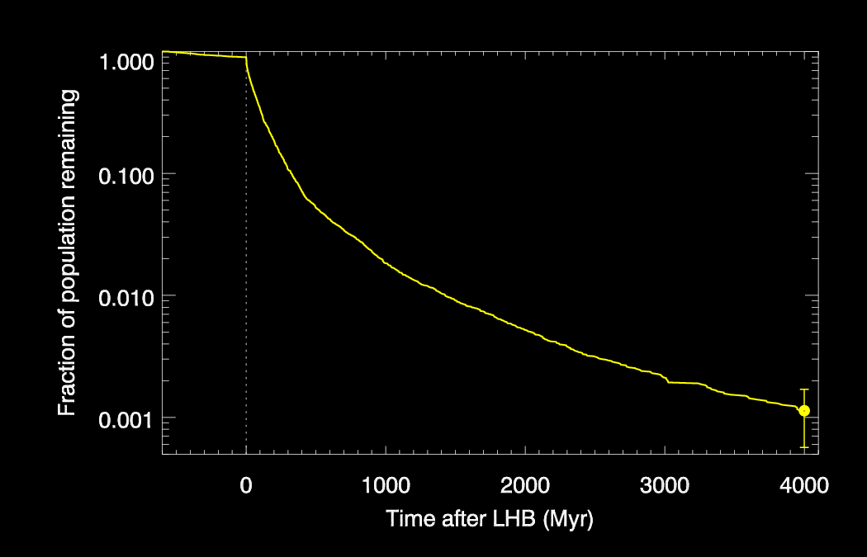
Depletion of E-Belt Population
Hungaria Population Today
LHB
Pre-LHB
Using observed Hungaria population, we predict
Initial E-belt had population density similar to pre-LHB main belt.
It produced ~9-10 lunar basins, with ~2-3 Imbrium/Orientale-sized.

Slide 52
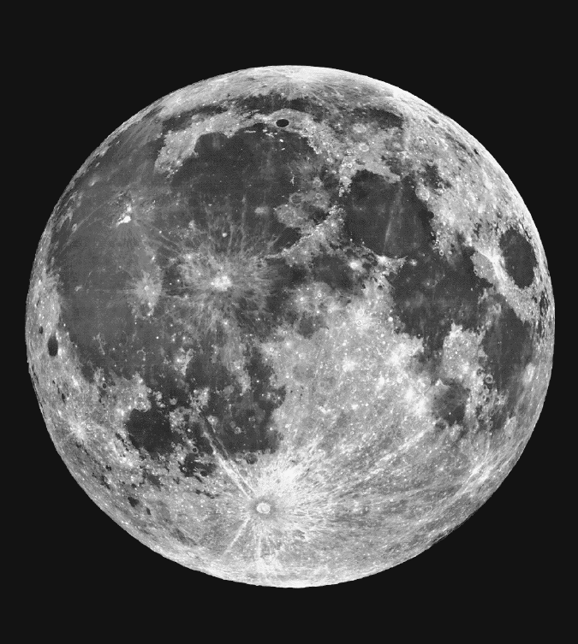
Lunar Basins (D > 300 km)
Apollo 14, 15
Apollo 17
Nectarian and Imbrian basins (~12 basins, or 1/3 of all basins) come from E-Belt & Main Belt.

Slide 53
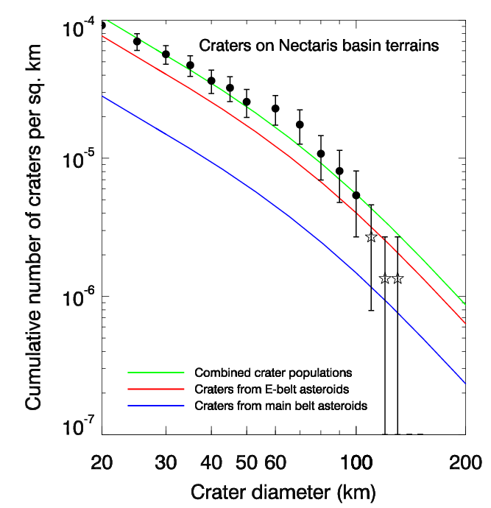
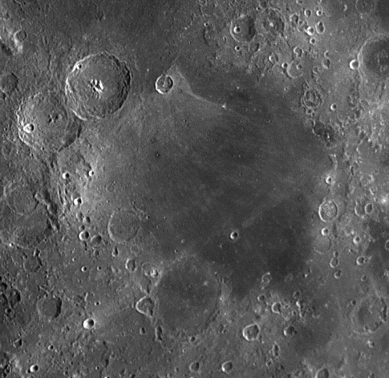
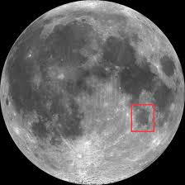
Craters on Nectaris Basin Terrains
Nectaris Basin
Our estimated E-belt and main belt populations produce the right number of craters on Nectaris basin terrains!
Craters from Marchi et al. (2012)

Slide 54
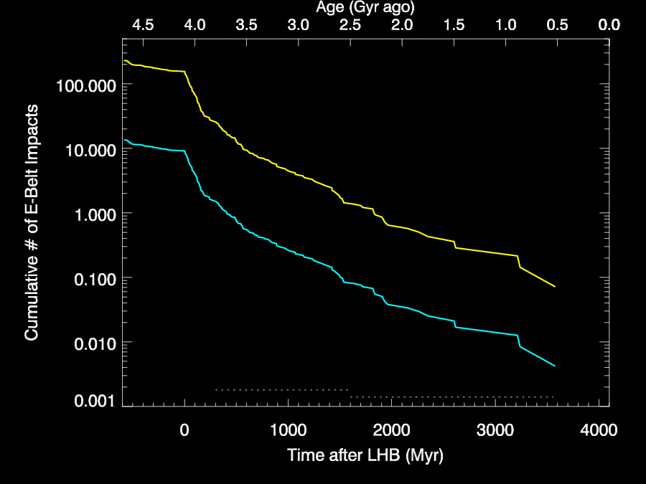
Basin Formation on the Earth and Moon
LHB
Earth
Orientale (~3.7-3.8 Ga)
Moon
Archean
Proterozoic
If the E-belt produced ~9 lunar basins:
Normalize using youngest basin Orientale with age of 3.7-3.8 Ga.
This predicts LHB starts at ~4.1-4.2 Ga and lasts ~400 My on Moon.

Slide 55
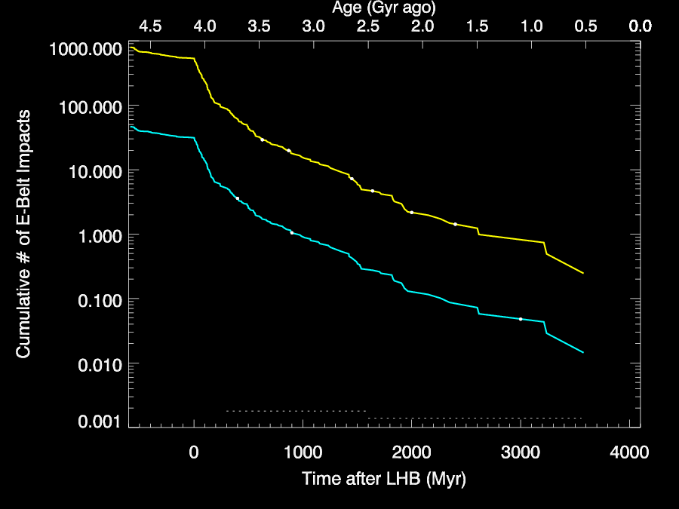
K/T-Sized Craters on the Earth and Moon
LHB
Earth
3-Model 3-Obs (3.2-3.7 Ga)
Moon
1 Model 1-Obs (1.5-3.2 Ga)
Cumulative Number of K/T or Larger Impacts
Archean
Proterozoic
K/T-size craters on Moon after 3.7 Ga (D > 150-300 km):
3 model and 3 observed craters in Late Imbrian (~3.2 to ~3.7 Ga).
1 model and 1 observed crater in Eratostenian (~1.5 to ~3.2 Ga).

Slide 56
K/T-Sized Craters on the Earth and Moon
LHB
Earth
Moon
Cumulative Number of K/T or Larger Impacts
Archean
Proterozoic
Look at all of the late Earth impacts! Can this be real?

Slide 57
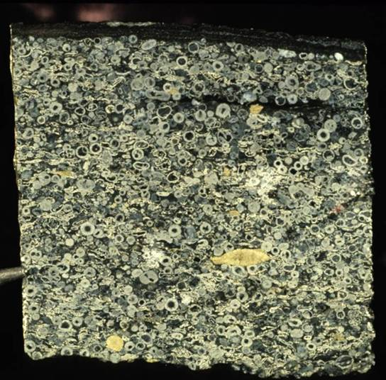
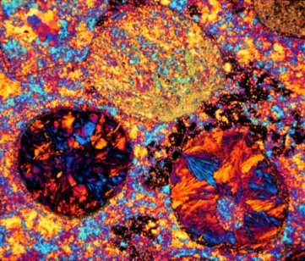
Impact Spherule Layers on Earth
2.63 Ga Spherules
K/T-sized impacts vaporize and eject silicates.
Melt droplets go above Earth’s atmosphere, cool, fall back, and produce global spherule beds.
While coverage gaps exist, spherule beds tell us about big impacts in Archean, even if the craters are now gone!
Kyte et al. (2003); Simonson and Glass (2004); Lowe and Byerly (2010); Johnson and Melosh (2012)

Slide 58
K/T-Sized Craters on the Earth and Moon
LHB
9-Model 10-Obs (3.23-3.47 Ga)
Earth
3-Model 4-Obs (2.49-2.63 Ga)
Moon
2-Model 2-Obs (1.6-2.1 Ga)
1-Model 0-Obs (0.6-1.6 Ga)
Cumulative Number of K/T or Larger Impacts
Archean
Proterozoic
Excellent match between model K/T-sized or larger events and spherule beds/craters over Archean & Proterozoic.

Slide 59
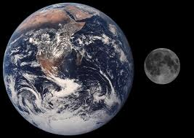
How Can The Earth Have Late Impactors?
95%
Probability of Hitting Earth
5%
Probability of Hitting Moon
60 Impactors:
~3 hit the Moon (5%)
The rest strike Earth
The Earth/Moon see the same impacting population, with the impactors hitting in ~20:1 ratio.

Slide 60
How Can The Earth Have Late Impactors?
95%
Probability of Hitting Earth
5%
Probability of Hitting Moon
10 Impactors:
None may hit the Moon
The Earth/Moon see the same impacting population, with the impactors hitting in ~20:1 ratio.

Slide 61
The LHB Did Not End 3.8 Gyr Ago!
~15 basins on Earth between 2.5-3.7 Ga.
Sizes similar to last ~15 lunar basins. Many should rival the size of Orientale!
~70 more K/T events from 1.8-3.7 Ga.
Vredefort and Sudbury: From late LHB?

Slide 62
Curious Coincidences – Only For Fun!
Archean Earth
Coincidences from the end of the big impacts (1.8-2.5 Ga):
“Great Oxidation Event” (~2.4 Ga).
Major continent building (2.5-2.7 Ga).
Oceans enter into stable euxinic state (lots of H₂S) after ~1.8 Ga.
The Story of the Early Earth and Life Is Probably Linked to Bombardment
Sample Reference: Kump and Barley (2007)

Slide 63
The Start of the Lunar Cataclysm and the Lunar Sawtooth Bombardment
Marchi, Bottke, Kring and Morbidelli (2012) EPSL Morbidelli, Marchi, Bottke, and Kring (2012) EPSL

Slide 64
Early Bombardment of the Moon
Our Story So Far…
Animation from GSFC
We argue there were two main components:
Early basins: From leftovers of accretion (< 4.45 Ga).
Late basins: From late giant planet migration at ~4.1-4.2 Ga that liberated asteroids and comets from stable regions.
Marchi, Bottke et al. (2012); Morbidelli et al. (2012); Bottke et al. (2012)

Slide 65
The Lunar “Sawtooth” Bombardment
Leftovers of Accretion
Leftovers of Accretion
LHB
LHB
Differential
Cumulative
Two phases: (1) Accretion leftovers & (2) Late Heavy Bombardment.
Morbidelli, Marchi, Bottke, and Kring (2012; EPSL)

Slide 66
The Lunar “Sawtooth” Bombardment
Leftovers of Accretion
Leftovers of Accretion
LHB
LHB
Differential
Cumulative
The sawtooth model matches lunar crater counts and chronology for Neukum/Hartmann between ~3 and 4.1 Ga.
Morbidelli, Marchi, Bottke, and Kring (2012; EPSL)

Slide 67
Link Between Impacts and Volcanism?
Mercury: Oldest cratered terrains have same age as global distributions of basins (~4 Ga)
Mercury resurfaced near start of LHB.
Marchi et al. (2013)

Slide 68
Using Asteroid and Lunar Samples to Constrain Late Heavy Bombardment
Marchi, Bottke et al. (2013)

Slide 69
Vesta and the HED Meteorites
³⁹Ar-⁴⁰Ar chronometer can be reset by moderate heating.
Few events between 4.1-4.4 Ga, though many between 3.5-4.1 Ga.
No sharp spike observed!
Bogard (1995; 2011); Bogard and Garrison (2003); Cohen et al. (2007)

Slide 70
Problem #1:
4.1-4.5 Gy Ago
Vesta
The Nice model predicts main belt massive until ~4.1 Ga. Vesta should have been beaten up!

Slide 71
Problem #1:
The Nice model predicts main belt massive until ~4.1 Ga. Vesta should have been beaten up!
Why do we see a “gap” in Ar-Ar from 4.1-4.4 Ga?

Slide 72
Problem #2:
< 4.1 Gy Ago
To explain lunar basins, main belt loses much of its mass ~4.1-4.2 Ga. This eliminates many potential impactors!

Slide 73
Problem #2:
To explain lunar basins, main belt loses much of its mass ~4.1-4.2 Ga. This eliminates many potential impactors!
Why do we see so many Ar-Ar ages between 3.5-4.1 Ga?

Slide 74
How Do We Make Ar-Ar Reset Ages?
Ar-Ar reset ages are likely produced by crater formation.
Crater debris must be hot enough long enough to strongly heat material in the breccia lens or ejecta blanket.
What kind of impacts can do this on Vesta?

Slide 75
Impact Simulations on Vesta
Temp (K)
Big Projectile
V = 5 km/s
>
Small Projectile
V = 18 km/s
<
High velocity impacts produce higher temperatures and heat a larger volume of material.
Simulations from Kai Wunnemann

Slide 76
Impact Heating Trends
Pierazzo et al. (1997)
How Much Heated Material Leaves Crater
V < 5 km/s: Relatively little heating takes place.
V > 10 km/s: Volume of heated material increases!
V > 15 km/s: Heated material scales with impact energy.
Pierazzo et al. (1997); Wunnemann et al. (2008); Barr and Citron (2011)

Slide 77
Impact Velocities on Vesta
V = 14 km/s
V = 10 km/s
V = 6 km/s
Main Belt
Most main belt asteroids strike Vesta at V < 6 km/s.
These events produce relatively little heating.
Bottke et al. (1994)

Slide 78
Impact Velocities on Vesta
V = 14 km/s
V = 10 km/s
V = 6 km/s
Main Belt
High V comes from high e orbits, which can still hit Vesta!
These impacts may produce ~1000 times more heating!
Bottke et al. (1994)

Slide 79
The LHB and Impact Heating on Vesta
Marchi, Bottke et al. (2012)

Slide 80
Vesta’s Impact History
Material with LHB ages:
Ejected by Rheasilvia ~1 Ga.
Now sitting in Vesta family.
4
1
1
2
3
4
2
3
Ar-Ar Ages Mark the Start of the LHB!

Slide 81
Impact History on H Chondrite Parent Body
Similar Ar-Ar Trends in H Chondrites!
Swindle et al. (2009)

Slide 82
Similar Ar-Ar Ages on Vesta and Moon?
Earth-crossing zone
The same population making Ar-Ar reset ages on Vesta and the H chondrite parent body also strikes the Moon.
Ar-Ar ages may tell us about the start of the LHB!

Slide 83
Testing the Leftovers of Accretion
Animations from GSFC
What Bombardment Happened Here?
Timing Unknown (4.1-4.45 Ga?)
Magma Ocean and Conductive Lid
Late Heavy Bombardment

Slide 84
The Lunar “Sawtooth” Bombardment
Leftovers of Accretion
Leftovers of Accretion
LHB
LHB
Differential
Cumulative
Two main phases of lunar bombardment:
Leftovers of Terrestrial Planet Accretion
Late Heavy Bombardment (LHB).
Morbidelli, Marchi, Bottke, and Kring (2012)

Slide 85
Impact Ages from Leftover Planetesimals
Terrestrial Planet Formation Models
Ar-Ar Ages for Chondrites
Leftover Planetesimals
from Terrestrial Planet Region
Main Belt
Bogard et al. (2011)
Many ancient Ar-Ar ages are between 4.35-4.53 Ga.
High V impacts from leftover planetesimals?

Slide 86
Conclusions
The LHB story so far, as told by asteroids and the Moon:
Triggered by late giant planet migration (e.g., the Nice model).
Solar system-wide event that may have started ~4.1-4.2 Ga.
On Moon, it may have started near formation time of Nectaris basin.
Many impactors derived from proposed main belt extension (E-Belt).
Basins: Occurred on Moon until ~3.7 Ga, but on Earth until ~2.5 Ga.
K/T-sized impacts: ~4 on Moon and ~60-80 on Earth from 1.8-3.7 Ga. The terrestrial events made Archean-era impact spherule beds.
3.5-4.1 Ga in Ar-Ar: High velocity impacts from asteroids ejected from main belt by late giant planet migration.

